Slide 1

MEDICAL FACILITY THEMATIC MAP
PROJECT BY:
AKRITI DHYANI-202319018
ANUSHA PARIDA-202319026
MANISHA SANTOSH SHETTY-202319028

Slide 2
GOAL AND OBJECTIVE
To know about the areas lagging behind medical facilities as recently due to increased medical risks for instance recently during Navaratri festivities of Gujarat took a tragic turn as the joyous rhythms of Garba were marred by a series of unexpected heart attack deaths.
At least 10 people lost their lives within a span of 24 hours, which included both teenagers and middle-aged adults.
About 500 ambulances were called for heart patients in Gujarat.
A medical facility thematic map could have helped in addressing heart-related incidents during Navaratri in Gujarat by helping local authorities and healthcare providers identify areas in need of increased healthcare resources and emergency preparedness.

Slide 3
SOFTWARES USED
ARC GIS
QGIS
POSTGRES SQL

Slide 4
PROCEDURE
Collected the location data of medical facilities, schools.
Extraction of the targeted shapefile using QGIS.
Used SQL for creating database of the following data.
Connected PostGres with QGIS to plot the location data.
Generation of thematic map using ARC-GIS.
Created a probability map of medical facilities using Machine Learning

Slide 5
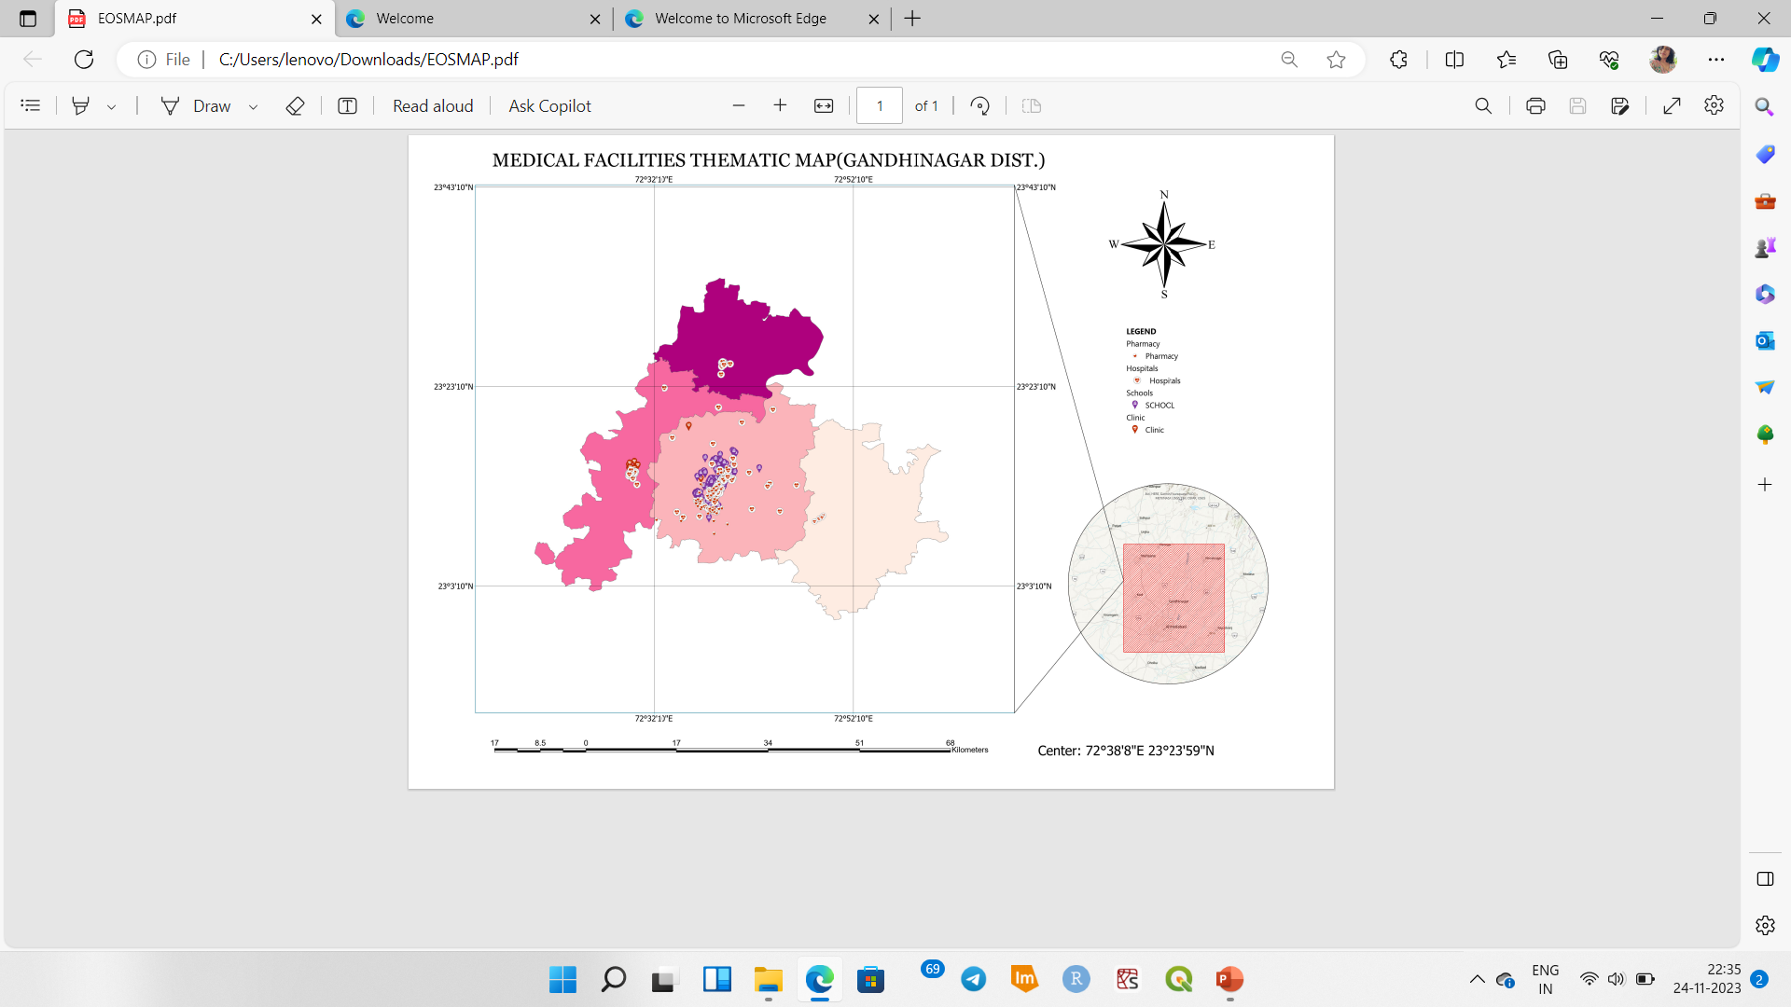
MAP

Slide 6
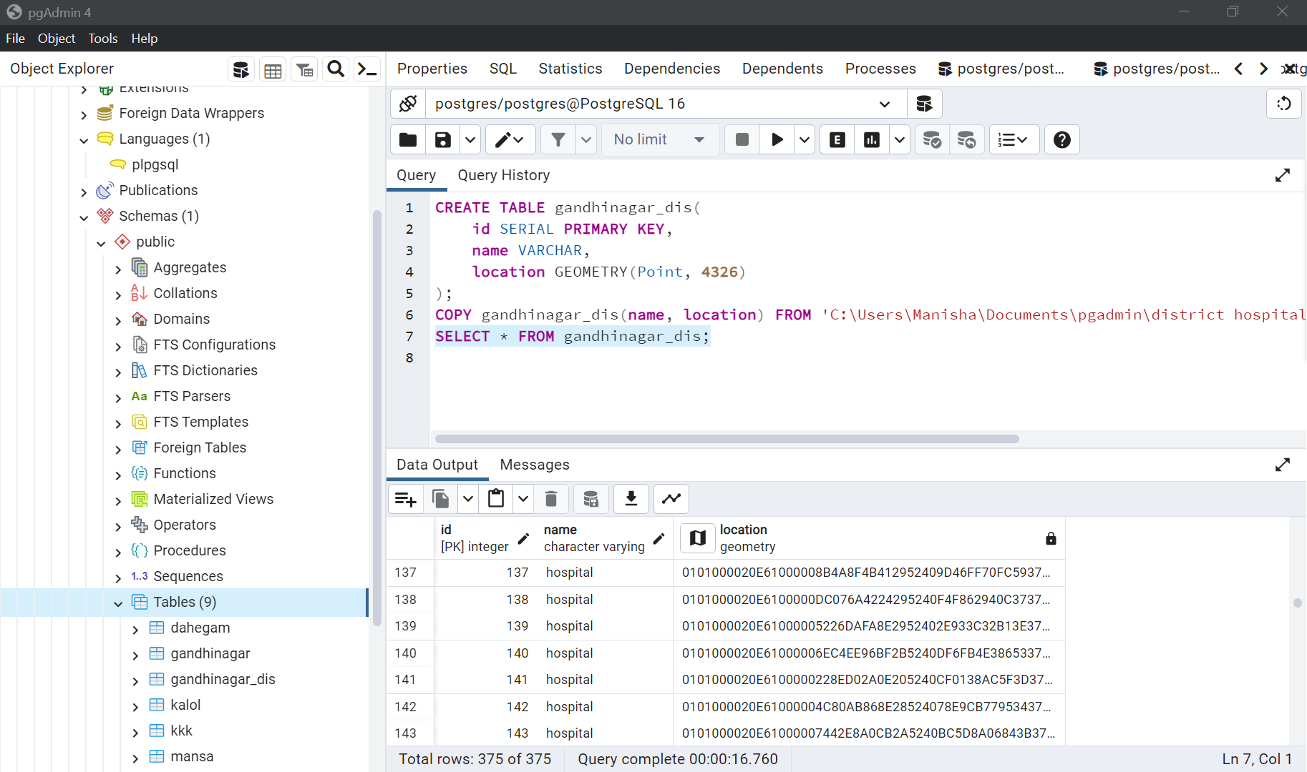
PLOTTING OF CO-ORDINATES USING SQL

Slide 7
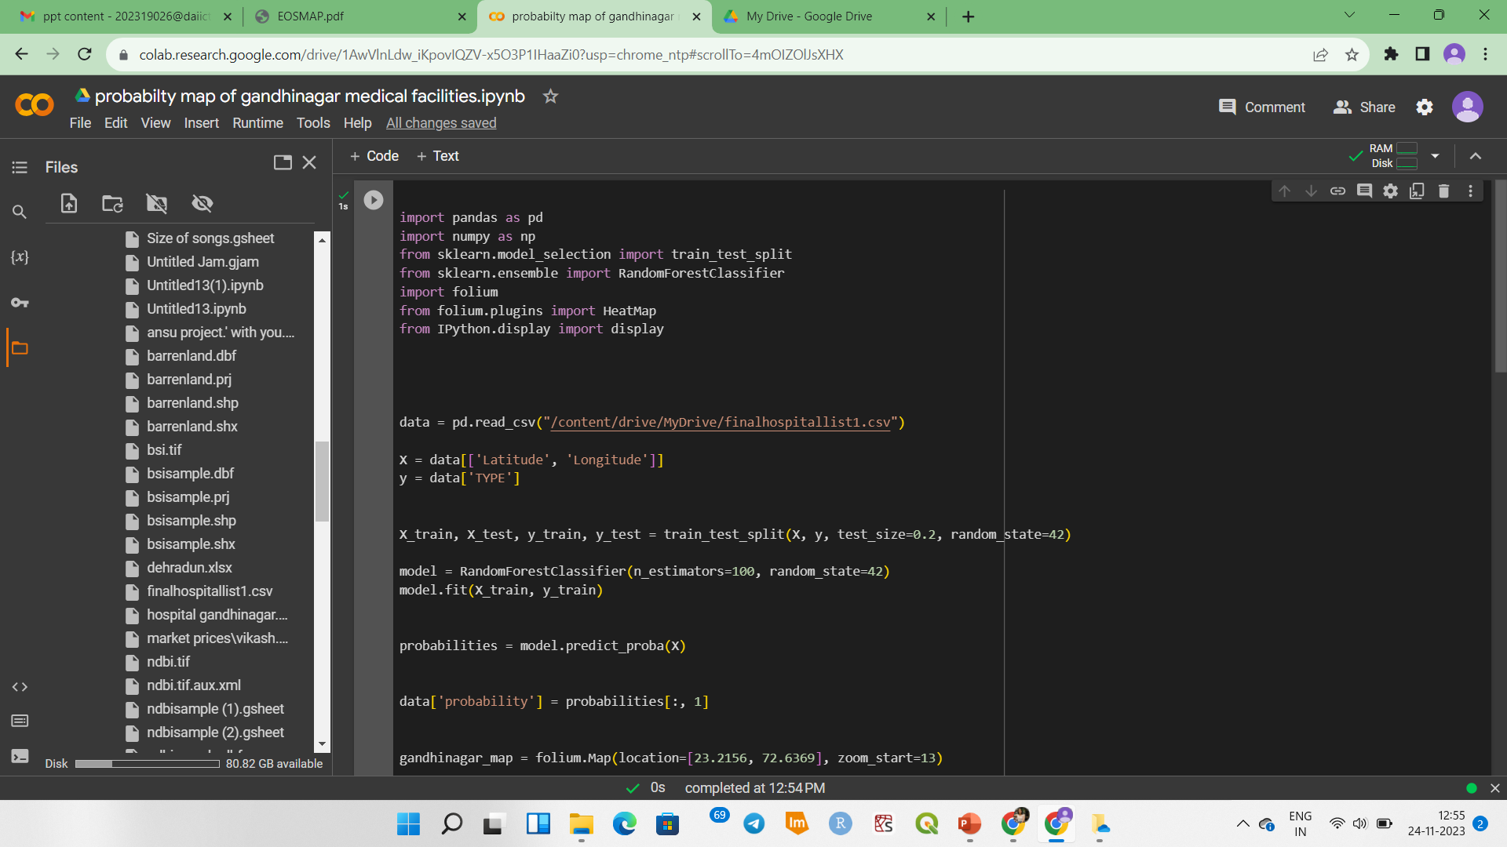
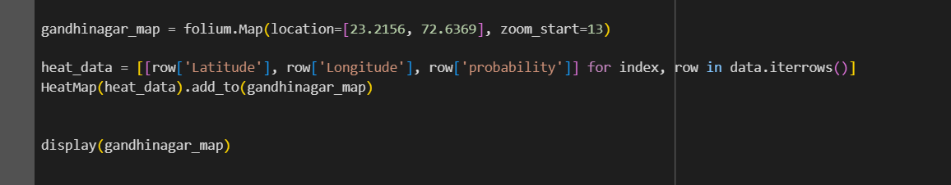
PROBABILITY CALCULATION OF MEDICAL FACILITIES
CODE SNIPPET

Slide 8
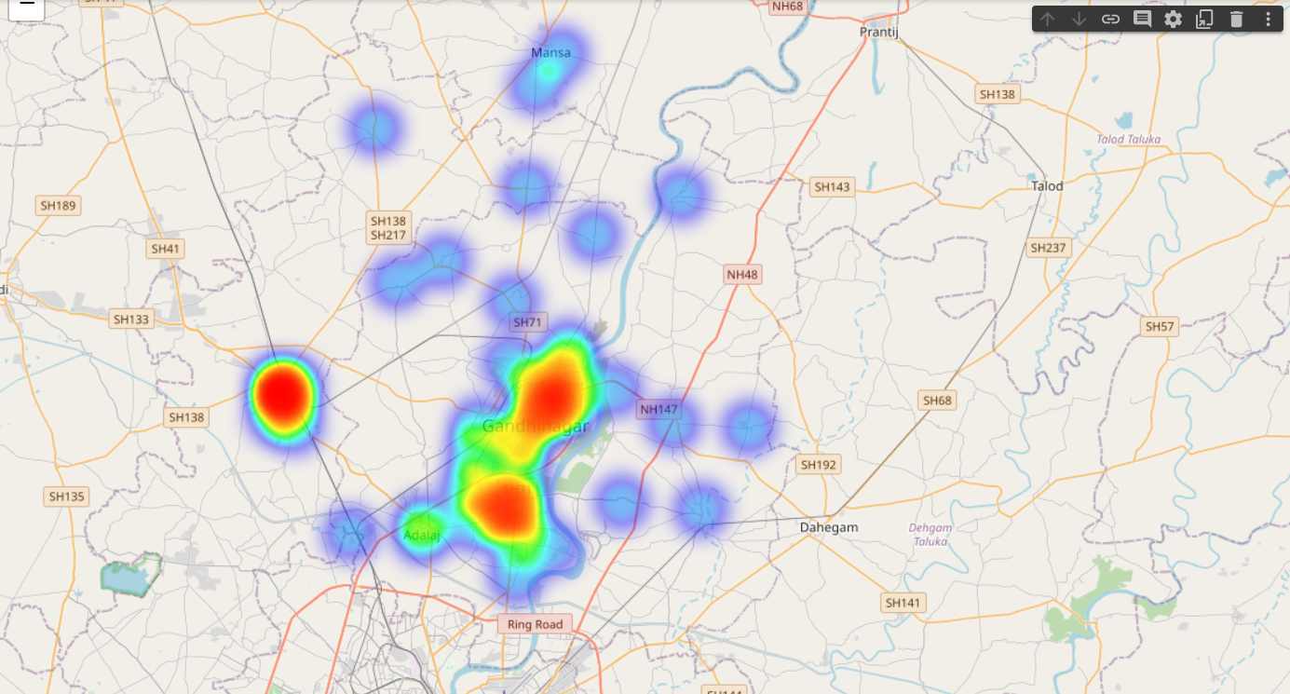
OUTPUT MAP OF PROBABILITY

Slide 9
DATA SOURCES
https://www.openstreetmap.org/
https://www.surveyofindia.gov.in/
https://timesofindia.indiatimes.com/city/ahmedabad/younger-hearts-losing-their-beat/articleshow/104662646.cms
https://gujecostat.gujarat.gov.in/uploads/mediafiles/6%20GANDHINAGAR%20ENG.pdf
https://earth.google.com/

Slide 10

This Photo by Unknown Author is licensed under CC BY-SA

